Slide 1



Pipeline Branch Prediction Strategies Implementation and Evaluation
Presented by
Bogki Yun, Yuguang Qiu, Qian Mai
April. 29th, 2014

Slide 2



Are these manufactory procedures familiar to you?

Slide 3


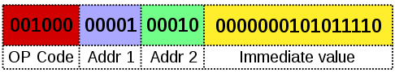
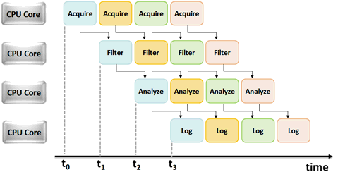
Pipeline

Slide 4
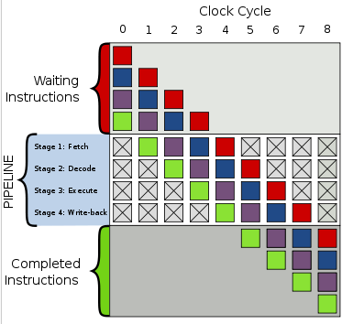
Pipeline
Example of 4-stage pipeline. The colored boxes represent instructions independent of each other
Notes:
Pipeline has 4 stages.
It works on instructions.

Slide 5

Outlines & Summary
Introduction and background
Motivation
Simulator Capability
Bimodal predictor
G-shared predictor
Hybrid predictor
Simulator Implementation
Code Compile
Code Analyse
Structure
Test Results and Evaluation
Conclusion

Slide 6
Introduction and background
High performance achievement - Pipelining
Branch instructions terminates the normal flow of program.
Branch result forces the change in the normal flow of the program.
Branch instructions inserts stalls and hinders the performance of the pipeline.
Programs written for a pipelined processor are sophisticated.
Hamper processor performance with deeper pipelines.
Notes:
1. Branch instructions are make - up a large portion of assemble programs.
2. No matter branch taken or not taken, it is determined at the execution stage while the next instruction is already at the decode stage.

Slide 7
Introduction and background
Branch prediction schemes are required to fix this problem by minimize the performance penalty from branching.
Branch predictors attempt to avoid the waste of time by trying to guess whether the conditional jump is most likely to be taken or not taken
If branches are predicted poorly, it may create more work for the processor.
Notes:
1. Branch instructions perform a test by evaluating a logical condition and depending on the outcome of the condition modify the program counter to take the branch or continue to the next instruction. The branch instructions are used to change the sequence of instruction execution.
2. Without branch prediction, the processor would have to wait until the conditional jump instruction has passed the execute stage before the next instruction can enter the fetch stage in the pipeline.
3. The time that is wasted in case of a branch mis-prediction is equal to the number of stages in the pipeline from the fetch stage to the execute stage. Modern microprocessors tend to have quite long pipelines so that the mis-prediction delay is between 10 and 20 clock cycles.
4. The longer the pipeline the greater the need for a good branch predictor.

Slide 8


Motivation and Project Goal
Study branch predictions and related knowledge
Implements a simulator of branch prediction strategies with the goal of finding a method to maximize the rate of correct predict.
Evaluate our ideas by comparing the performance of several existing prediction schemes and find some efficient methods to improve the branch prediction strategies
Goal: To design a branch predictor simulator and use it to decide these current branch predictors well

Slide 9
Branch Prediction & Branch Predictor
In computer architecture:
A branch predictor
is a digital circuit that tries to guess which way a branch (e.g. an if-then-else structure) will go before this is known for sure.
A Branch predication
is a strategy in computer architecture design for mitigating the costs usually associated with conditional branches, particularly branches to short sections of code.

Slide 10
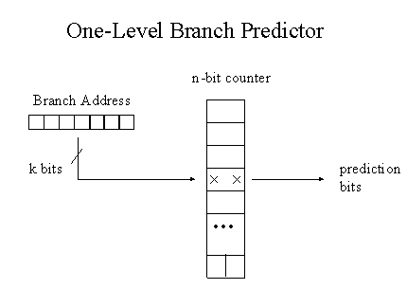
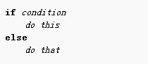
Branch Prediction & Branch Predictor
Digital
Circuit
Strategy

Slide 11
Branch Predictor Classification
Static Prediction
The direction of each branch is predicted before a programs runs using either compile time or profiling.
Static Branch prediction policies of "always predict taken" and "always predict not taken".
Dynamic Prediction
The direction of each branch is predicted by recording information, in hardware, of past branch history during a program’s execution.
The predictor selects a counter from the table using the lower-order n bits of the instruction's address. The direction prediction is made based on the value of the counter.
Notes:
For (int i=0; t<1000)
99.9%
If (i>1000)
50%, we don’t know if the instruction is less than 1000 or bigger.

Slide 12
Branch Predictor Classification
TAKEN
Static
Prediction
NOT- TAKEN
Decode History Table (DHT)
Branch History Table (BHT)
Combination BHT-DHT
Correlation - Based Prediction
Two-Level Adaptive Prediction
Skewed branch predictor
Gshare branch predictor
Branch Predictors
Dynamic
Prediction

Slide 13
Simulator Capabilities
Bimodal Predictor
G-share Predictor
Hybrid Predictor

Slide 14
Local & Global Predictor
Local Branch Prediction Schemes
- Per branch address
■ Global Branch Prediction Schemes
❑ - Combined all branch addresses
Notes:
A local branch predictor has a separate history buffer for each conditional jump instruction.
A global branch predictor does not keep a separate history record for each conditional jump. Instead it keeps a shared history of all conditional jumps.

Slide 15

G-share Predictor

Slide 16
G-share Predictor
G-share is a variation on the basic global prediction scheme.
Global prediction technique uses the combined history of all recent branches in making a prediction.
G-share algorithm uses two levels of branch-history information to dynamically predict the direction of branches.
G-share algorithm works by taking the lower bits of the branch target address and make them work with the history register to get the index that should be used with the prediction table.

Slide 17
G-share Predictor
Model a G-share branch predictor with parameters {m, n}
M= The number of low-order PC bits used to form the prediction table index.
Note: Discard the lowest two bits of the PC, since these are always zero
N= is the number of bits in the global branch history register. n ≤ m.
Note: n may equal zero, in which case we have the simple bimodal branch predictor.

Slide 18
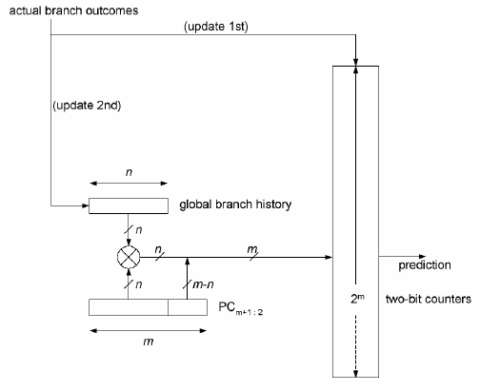
G-share Predictor
The number of bits in the global branch history register
Shift register ,1- taken/ 0-untaken
The number of low-order PC bits used to form the prediction table index.
Notes:
The pattern history tabe 2M

Slide 19
G-share Predictor
Two levels registers
First Level
The first level registers the history of the last k branches faced. This level is implemented by providing a global branch history register.
A shift register that enters a 1 for every taken branch and a 0 for every untaken branch.
Second Level
The second level of branch history information registers the branching of the last occurrences of the specific pattern of the k branches.
This information is kept in the branch prediction table.

Slide 20
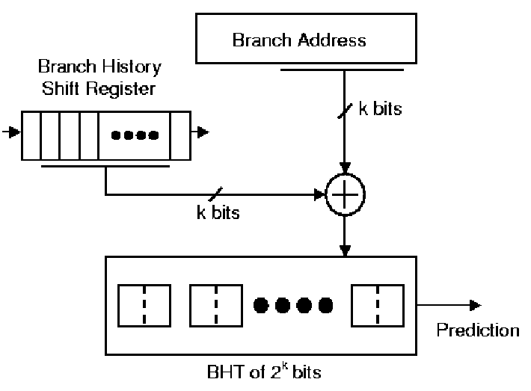
G-share Predictor
First Level
Here a = k
BHR
(k bits)
k low bits of branch address
XOR
(bitwise XOR)
2-bit saturating counters (predictors)
Index Into Second Level
Second Level
One PHT
Global branch history register, XOR with the upper PC bits
One Pattern History Table (PHT) with 2^{k} entries (predictors)
Notes:
The first level registers the history of the last k branches faced. This level is implemented by providing a global branch history register.
A shift register that enters a 1 for every taken branch and a 0 for every untaken branch.
------------------------
The second level of branch history information registers the branching of the last occurrences of the specific pattern of the k branches.
This information is kept in the branch history table

Slide 21

Bimodal Predictor

Slide 22
Bimodal Predictor
The bimodal prediction usually serve as the local predictor.
It is a state machine with four states:
Strongly not taken
Weakly not taken
Weakly taken
Strongly taken
The bimodal scheme requires the use of a prediction buffer indexed by the program counter value.
Makes a prediction based on the direction the branch went the last few times it was executed.

Slide 23
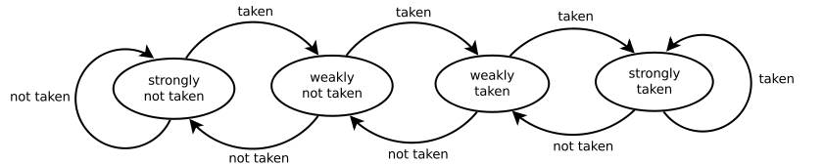
Bimodal Predictor
When a branch is evaluated, the corresponding state machine is updated.
Branches evaluated as not taken the state towards strongly not taken
Branches evaluated as taken the state towards strongly taken
Notes:
Strongly not-taken – 00(value)
01
10
11

Slide 24
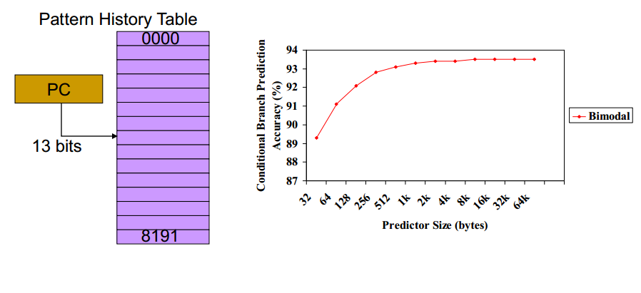
Bimodal Predictor

Slide 25

hybrid predictor

Slide 26
Hybrid Predictor
Model a hybrid predictor that selects between the bimodal and the G-share predictors, using a chooser table of 2k two-bit counters.
Selection rule:
If the chooser counter = 2 or 3 Selects the G-share
Otherwise Selects the bimodal
Note: Each predictor entry is a two-bit counter

Slide 27
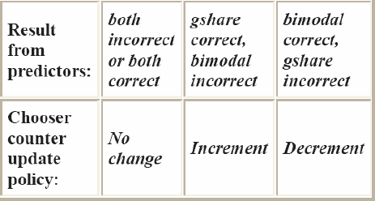
Hybrid Predictor
Update rules:
Other rules:
1. As with the other counters, it saturates at 0 and 3.
2. All counters in the chooser are initialized to 1 at the beginning of the simulation.
3. The index for the chooser table is bit k+1 to bit 2 of the branch PC

Slide 28
Hybrid Predictor
Input:
The simulator reads a trace file in the following format:
<hex branch PC> t|n
<hex branch PC> t|n
Where:
· <hex branch PC> holds the address of the branch instruction in memory. This field is used to index into predictors.
· "t" indicates the branch is actually taken (Note! Not that it is predicted taken!). Similarly, "n“ indicates the branch is actually not taken.
Example:
00a3b5fc t
00a3b604 t
00a3b60c n
...

Slide 29
Hybrid Predictor
Output:
Number of accesses to the predictor (i.e., number of branches)
Number of branch mis-predictions (predicted taken when not-taken, or predicted not-taken when taken), and
Branch mis-prediction rate (# mis-predictions/# branches).

Slide 30
Branch Predictor Implementation
Code Compile
Code Analyse
Structure

Slide 31
Compiling and Running Simulator
Steps:
Source file designed is compatible to Sun-OS, Dos, or Windows
The simulator simulates the performance of the two different types of Branch Predictor, bimodal and G-share.
In all the two cases we have to give the command line parameters.

Slide 32
Compiling and Running Simulator
Bimodal predictor
<name> in this case bimodal
<M2>
<trace file>
e.g. $ sim bimodal 5 gcc_trace.txt

Slide 33
Compiling and Running Simulator
G-share predictor
<name> in this case bimodal
<M1>
<N>
<trace file>
e.g. $ sim gshare 5 3 gcc_trace.txt With the following constraints, N ≤ M1

Slide 34
Compiling and Running Simulator
Hybrid predictor
<name> in this case hybrid
<K>
<M1>
<N>
<M2>
<trace file>
e.g. sim hybrid 4 12 6 7 gcc_trace.txt

Slide 35
Compiling and Running Simulator
Source file designed is compatible to Sun-OS, Dos, or Windows.
The simulator simulates the performance of the two different types of Branch Predictor, bimodal and G-share.
In all the two cases we have to give the command line parameters.

Slide 36

Compiling and Running Simulator
Develop Environment - GCC - Eclipse C++/C - Cygwin for Windows
Windows 8.1

Slide 37
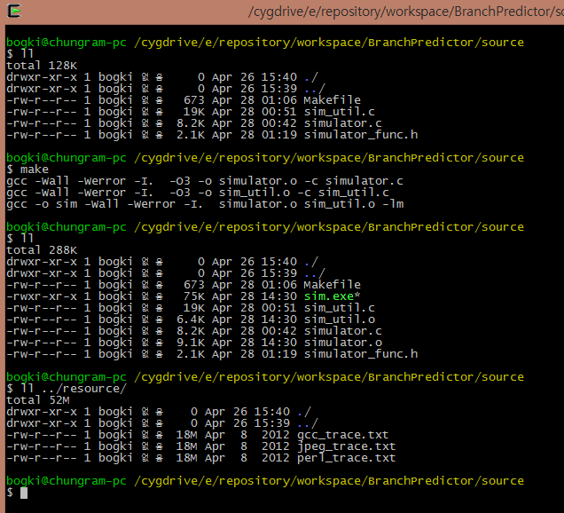
Compiling and Running Simulator
Source File
Compile &
Execution File
Trace File

Slide 38
Branch Predictor Implementation
Flowchart
Initialize Variable
Trace File Reading
Predict &
Compare
Print the Results

Slide 39
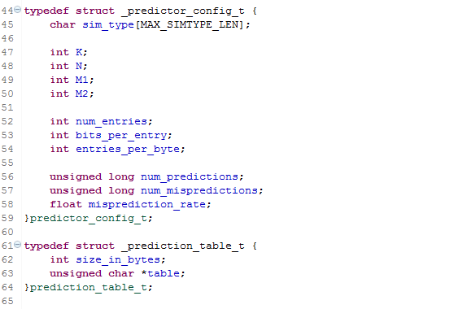
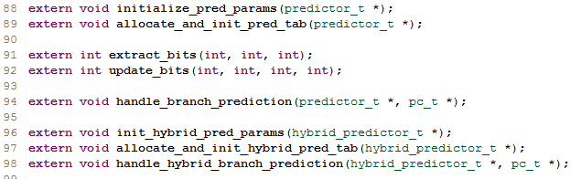
Branch Predictor Implementation
Flowchart
Initialize Variable
Trace File Reading
Predict &
Compare
Print the Results

Slide 40
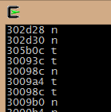
Branch Predictor Implementation
Flowchart
Initialize Variable
Trace File Reading
We’ve used Pin, a binary instrumentation tool, to generate a trace of branches and their outcomes.
Conditional branches from execution of three programs - gcc, perl, jpeg.
As unconditional branches are always taken, it is excluded from this trace file.
The first field is the address of the branch instruction.
The second is the character “t” or “n” for branch taken or not taken.
* Pin is a kind of program Instrumentation and Profiling. (https://software.intel.com/en-us/articles/pin-a-dynamic-binary-instrumentation-tool)
Predict &
Compare
Print the Results

Slide 41
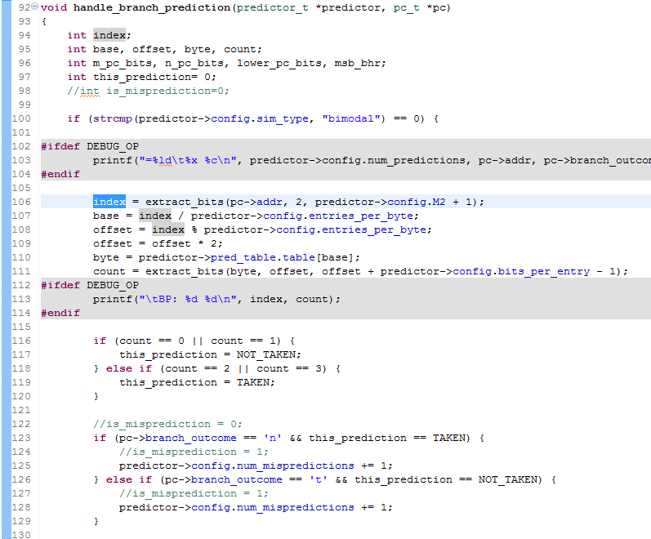
Branch Predictor Implementation
Flowchart
Initialize Variable
bimodal
Trace File Reading
Predict &
Compare
Print the Results

Slide 42
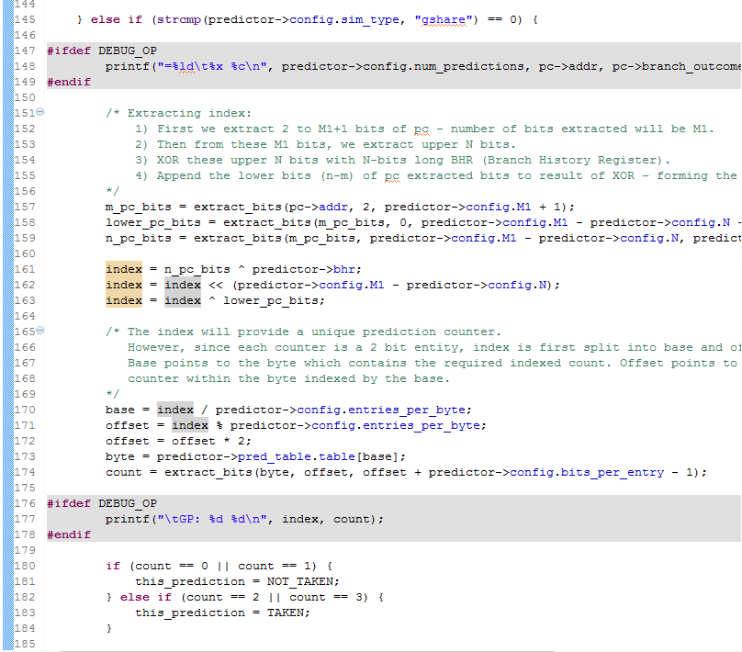
Branch Predictor Implementation
Flowchart
gshare
Initialize Variable
Trace File Reading
Predict &
Compare
Print the Results

Slide 43
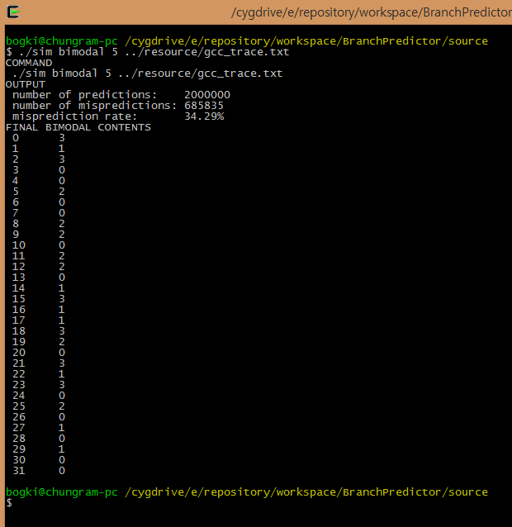
Branch Predictor Implementation
Flowchart
Initialize Variable
Trace File Reading
Predict &
Compare
Print the Results

Slide 44
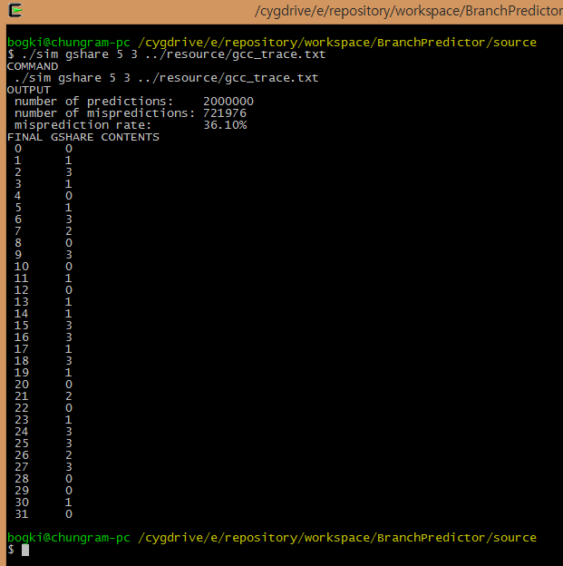
Branch Predictor Implementation
Flowchart
Initialize Variable
Trace File Reading
Predict &
Compare
Print the Results

Slide 45
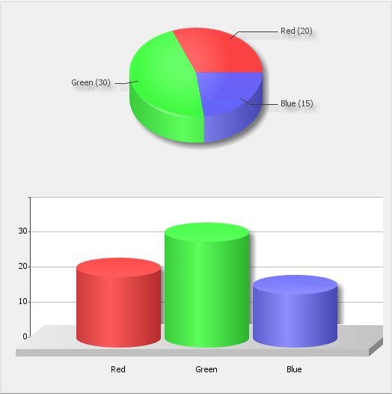
Test Result and Evaluation

Slide 46
Simulation
The Parameters in the Cache Simulation
Calculations
Mis-prediction Rate
gcc_trace.txt
jpeg_trace.txt
perl_trace.txt
Combined results for bimodal predictor
Combined results for gshare predictor
Analysis and Conclusion

Slide 47
The Parameters in the Cache Simulation

Slide 48
Calculations
Bimodal Predictor
G-share Predictor
Hybrid Predictor

Slide 49
Mis-prediction Rate of Bimodal Predictor for gcc_trace.txt

Slide 50
Mis-prediction Rate of G-share Predictor for gcc_trace.txt

Slide 51
Mis-prediction Rate of G-share Predictor for
gcc_trace.txt cont'd

Slide 52
Mis-prediction Rate of G-share Predictor for gcc_trace.txt

Slide 53
Mis-prediction Rate of Bimodal Predictor for jpeg_trace.txt

Slide 54
Mis-prediction Rate of G-share Predictor for jpeg_trace.txt

Slide 55
Mis-prediction Rate of G-share Predictor for jpeg_trace.txt cont'd

Slide 56
Mis-prediction Rate of G-share Predictor for jpeg_trace.txt

Slide 57
Mis-prediction Rate of Bimodal Predictor for perl_trace.txt

Slide 58
Mis-prediction Rate of G-share Predictor for perl_trace.txt

Slide 59
Mis-prediction Rate of G-share Predictor for perl_trace.txt cont'd

Slide 60
Mis-prediction Rate of G-share Predictor for perl_trace.txt

Slide 61
Combined results for bimodal predictor

Slide 62
Combined results for bimodal predictor
Saturate points

Slide 63
Combined results for gshare predictor

Slide 64
Combined results for gshare predictor
Selection Points

Slide 65
Combined results for gshare predictor

Slide 66
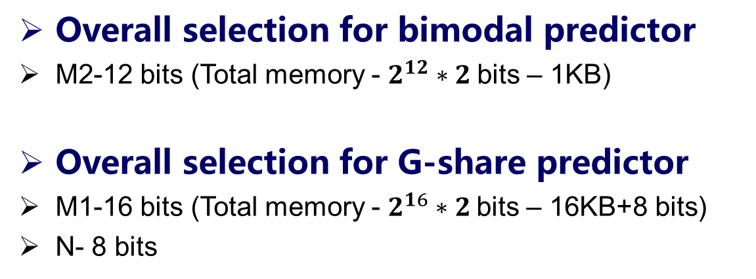
Analysis
Overall selection for bimodal predictor
M2-12 bits (Total memory - $2^{12}∗2$bits – 1KB)
Overall selection for G-share predictor
M1-16 bits (Total memory - $2^{16}∗2$bits – 16KB+8 bits)
N- 8 bits

Slide 67
Conclusion
Choose Professor Gita’s class again in the future, because you can really learn something from that.
The mis-prediction rate of a branch predictor decrease as the values of the branch predictor’s parameters increased. It also increases the predictor’s size. The performance tends to saturate after a certain point and then the improvement becomes relatively small for larger parameters.
The simulations shows that benchmarks defer in their behavior resulting different mis-prediction rates.
The types of applications used largely affect a branch predictor’s behavior.

Slide 68
THANK YOU!

Slide 69
Reference
[1] Smith, J.E., “A Study of Branch Prediction Strategies”, Proceedings of the 8th annual symposium on Computer Architectures 1981, IEEE Computer Society Press: Minneapolis, Minnesota, USA. p. 135-148
[2] Yeh, T.-Y. and Y.N. Patt, “Two-level adaptive training branch prediction”, Proceedings of the 24th annual international symposium on Microarchitecture 1991.
[3] McFarling, “Combining Branch Predictors”, WRL Technical Note TN-36, Digital Equipment Corporation, June 1993
[4] Michaud, Pierre, Andre Siznec, Richard Uhlig, “Skewed branch predictors”, Tech. report, IRISA publ. int. 1031, June 1996
[5] Michaud, P., et al., “Trading conflict and capacity Aliasing in conditional branch predictors”, Proceedings of the 24th annual international symposium on Computer architecture, 1997.
[6] McFarling, S., “Combining branch predictors”, Compaq Computer Corporation Western Research Laboratory, 1993.
[7] D. Burger, T.M.A., and S.Bennett, “Evaluating future micro-processors: the SimpleSclar tool set”, Technical Report CS-TR-1996-1308, University of Wisconsin-Madison, 1996

Slide 70


Any questions

